Slide 1




Case dismissed?
The dangers of the new Rule 48.14 (Administrative dismissals)
PowerPoint prepared by LAWPRO
Notes:
[See instructions on how to use this PowerPoint on the second slide]
As of January 1, 2015 we have a new Rule 48 (the administrative dismissals rule).
This presentation will update you on Rule 48 changes – and some of the hidden nuances and “gotchas” that could expose you to malpractice claims.

Slide 2
How to use this PowerPoint
Law firms are encouraged to use it to train lawyers and staff on the best practices for avoiding Rule 48-related administrative dismissals.
There are notes on each slide with additional commentary to help the presenter.
For a reasonable sized audience LAWPRO will consider sending a speaker to do this presentation. Contact Dan Pinnington (see below).
This PowerPoint was prepared as part of LAWPRO’s Rule 48 Transition Toolkit which contains additional information and resources (practicepro.ca/rule48).
For further information on Rule 48 claims and claims prevention contact Dan Pinnington, Vice President Claims Prevention & Stakeholder Relations, LAWPRO, at (416) 598-5863 or 1-800-410-1013 or dan.pinnington@lawpro.ca
Notes:
See text on slide.

Slide 3
Agenda
Old Rule 48
New Rule 48
Avoiding administrative dismissals
Most common causes of claims
Rule 48 Transition Toolkit
  Firm checklist
  Individual file checklist
  File progress plan
Notes:
Today we will cover the following topics:
First we will provide a brief history of the old Rule 48, including why LAWPRO really didn’t like it.
Then we will discuss the new Rule 48, and in particular we will highlight the changes.
Next we walk through what to watch for and how to avoid a dismissal of an action.
We then review the most common causes of Rule 48-related LAWPRO claims.
And we finish with some to-dos for you and your firm. We highlight the tools to help you in our new Rule 48 Transition Toolkit.

Slide 4
Old Rule 48 (2010-2014)
Action may be dismissed 2 years after Statement of Defence filed
Action may be dismissed where Statement of Defence not filed within 180 days of claim
Notices sent for status hearings prior to dismissal – opportunity to make it right
Lots of people unhappy with old rule
  Not practical to deal with tens of thousands of dormant matters
  Very expensive for LAWPRO…
Notes:
Under the old Rule 48 actions were dismissed because they were not set down after 2 years after a Statement of Defence was filed or because a Statement of Defence was not filed in time.
Prior to an administrative dismissal, lawyers were given the opportunity to rescue cases as they received a notice from the court to attend a status hearing.
Lots of people were not happy with the old rules 48.14 and 48.15.
In particular, court staff struggled with how do deal with tens of thousand of open but dormant matters.
Courts were overwhelmed with administrating status hearings. It was simply not practical.
LAWPRO saw an increase in malpractice claims… see next slide.

Slide 5
Cost of old
Rule 48 claims
$11+ million
Year | Number of Claims | Cost (Incurred)
2012 | 194 | $3.7 million
2013 | 239 | $2.7 million
2014 | 219 | $2.6 million
2015 | 95 | $1.5 million
2016 | 31 | $517,000
Notes:
Why was LAWPRO very unhappy with the old Rule 48.14?
The cases facing dismissal resulted in several hundred claims and over $11 million in claims costs in 5+ years -- see stats on slide.
A spike in claims occurred as courts started to deal with dormant files and time consuming status hearings.
For a wide variety of reasons – which we will highlight in more detail - lawyers either did not take timely steps or did not respond to status hearing notices.

Slide 6
The new Rule 48.14
Ontario Regulation 170/14
  Sept. 6, 2014 Ontario Gazette
Existing Rules 48.14 (Action not on trial list) and 48.15 (Action abandoned) revoked
New Rule 48.14 (Dismissal of an action for delay) substituted in their place
Notes:
It was clear to all that the status quo could not continue.
Court staff, members of the judiciary and the Rules Committee, Law Society staff and benchers, and LAWPRO staff consulted for over a year, which resulted in the new Rule 48.14.
By Ontario Regulation 170/14, on Sept. 6, 2014 in the Ontario Gazette, existing Rule 48.14 (Action not on trial list) was updated and 48.15 (Action abandoned) was revoked. The new Rule 48.14 (Dismissal of an action for delay) was substituted.

Slide 7
The dangers are in the details
  LAWPRO hopes new rule will reduce claims overall
But big changes and hidden nuances create some new claims risks
Lawyers and law firm staff need to be familiar with the changes
This presentation summarizes the key changes and highlights the dangers
Notes:
LAWPRO hopes the new Rule 48.14 will help reduce claims.
But there are some big changes and some hidden nuances that create some new claims risks.
Lawyers need to be familiar with these changes.
This presentation will give you a summary of the changes, and highlight the dangers so you can avoid them.

Slide 8
The major changes:
Actions will be automatically dismissed for delay if not set down for trial 5 years after commencement
Any action struck from trial list, and not restored by second anniversary of being struck, will be dismissed on that date
These dismissals happen:
  Without notice to parties or their counsel
  Unless the court orders otherwise
    Consent timetable or status hearing
Notes:
There are two really big changes you need to be aware of.
First, automatic dismissals of claims occur in these scenarios:
actions will be automatically dismissed for delay if not set down for trial 5 years after commencement, and
any action struck from trial list, and not restored by second anniversary of being struck, will be dismissed on that date.
Second, you will no longer receive a status notice to attend a status hearing.
Status hearings have mostly been eliminated. The only time you’ll go to a status hearing is if one has been previously booked, if counsel has brought a motion for a status hearing, or if a court orders one.
This means the onus is completely on you and your staff to make sure your file does not languish past the dismissal date. The court will not provide you with any warning that your file is old and about to be dismissed. We will go through the steps you need to take later in this presentation.

Slide 9
The key dates:
New rule effective January 1, 2015
“5 year automatic dismissal rule” applies to actions commenced on or after January 1, 2012 (updated preamble to SOC & NOA)
Actions commenced before January 1, 2012, will be dismissed January 1, 2017
  Transition provisions impact older actions…
Notes:
The language in the new Rule is confusing – here are the key dates you need to know about:
The new Rule 48 is effective January 1, 2015.
The “5 year automatic dismissal rule” applies to actions commenced on or after January 1, 2012 (updated preamble to SOC & NOA).
Actions commenced before January 1, 2012, will be dismissed January 1, 2017.
Transition provisions impact older actions…

Slide 10
Transition provisions
Status hearings scheduled, but not held, before January 1, 2015, will proceed under old Rule 48.14
Old Rules 48.14 and 48.15 status notices received prior to January 1, 2015, cease to have effect on that date
  Unless a status hearing has already been scheduled, or the action has already been dismissed
Notes:
There should be few matters under the transition rules as there have been no new status hearings scheduled as of November 2014.
Status hearings scheduled, but not held, before January 1, 2015, will proceed under old Rule 48.14.
Old Rules 48.14 and 48.15 status notices received prior to January 1, 2015, cease to have effect on that date, unless a status hearing has already been scheduled, or the action has already been dismissed.

Slide 11
The new dismissal process
No notice before dismissal
After dismissal, the registrar will serve a Rule 48.14 dismissal order (Form 48D)
Any lawyer served with dismissal order must promptly give a copy to his or her client
If you get one of these there is a potential claim
  Notify LAWPRO!
Notes:
The key here is there will no longer be any notice before a dismissal.
After dismissal, the registrar will serve a Rule 48.14 dismissal order (Form 48D).
Any lawyer served with dismissal order must promptly give a copy to his or her client.
If you get one of these there is a potential claim, so notify LAWPRO!

Slide 12
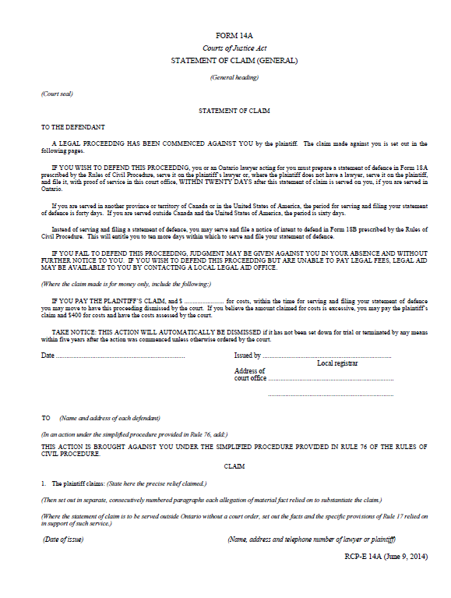

Updated preamble to Statement of Claim and Notice of Action
TAKE NOTICE: THIS ACTION WILL AUTOMATICALLY BE DISMISSED if it has not been set down for trial or terminated by any means within five years after the action was commenced unless otherwise ordered by the court.
Notes:
When commencing an action you must include in the preamble a warning of the 5 year automatic dismissal rule.
Failure to include the warning can mean that a Statement of Claim or Notice of Action is rejected by the Court. In this case you may risk missing limitation periods.
Both the Statement of Claim, Form 14A, and the Notice of Action, Form 14C, require the new wording, as illustrated in the slide: “TAKE NOTICE: THIS ACTION WILL AUTOMATICALLY BE DISMISSED if it has not been set down for trial or terminated by any means within five years after the action was commenced unless otherwise ordered by the court.”
Make sure that all your Statements of Claim and Notices of Action include this preamble. Remember, court forms can be downloaded at www.ontariocourtforms.on.ca/english/civil

Slide 13
Small Claims Court Actions Too
Action will be automatically dismissed without notice if:
  2 or more years have passed since the Plaintiff’s Claim;
  Motion in writing for assessment of damages has not been filed; and
  Trial or assessment hearing date has not been requested by the plaintiff
Dismissal on later of September 1, 2017 or 2 years from action’s start date
Notes:
Small claims court actions will be dismissed on the later of September 1, 2017 or 2 years from the action’s start date, if:
More than 2 years have passed since the Plaintiff’s Claim was issued;
Motion in writing for assessment of damages has not been filed; and
Trial or assessment hearing date has not been requested by the plaintiff
No notice will be provided that an action will be dismissed!

Slide 14

3 ways to avoid dismissal
Notes:
In the following slides we will take a look at three ways to avoid dismissal.
The best way is to move your file along!

Slide 15
3 ways to avoid dismissal
Before the deadline:
1. Set the matter down
2. On consent, file timetable & order
3. No consent? Bring a motion
Notes:
Of the 3 ways to avoid dismissal, by far the best is to move your action along so that you can set the matter down in a timely manner. There are numerous benefits to doing so, which we’ll cover in the next slide.
The other 2 ways apply when you are unable to set the matter down by the dismissal date. In this case seek consent from all parties to file a timetable and draft order with the court. If you can do this then it’s smooth sailing from there.
If you cannot obtain consent, then you must bring a motion for a status hearing before the dismissal deadline.
Keep in mind that in some jurisdictions you must book a motion well in advance of the hearing date. For this reason we suggest booking a status motion as soon as possible, once it is apparent that consent cannot be obtained.
If a status hearing is contested then notify LAWPRO, as you now have a file that may result in a claim against you.

Slide 16
Move the matter along so you can set it down
1
Benefits include:
  Obtain evidence early
  Save disbursements
  Get WIP paid
  Keep clients happy
Tip: once discoveries are complete, put your mind to setting the matter down
Notes:
There are a number of benefits to taking timely litigation steps:
-obtain evidence early. Records disappear over time and witnesses’ memories decay. Taking early steps ensures you get the evidence you need.
-save on disbursements. The longer your file goes, the more disbursements you will spend. You will need to get clinical notes and records updated, expert reports updated, etc. Every update can exponentially increase the cost of the litigation.
-clients may cut down your Work In Progress (WIP) if the litigation goes for too long, citing unnecessary time and costs. Prevent this from happening by taking timely steps.
-clients want their cases over with. Keep clients happy and reduce stress by resolving cases quickly.
-once discoveries are complete, think about what undertakings are really needed and prepare to set the matter down.

Slide 17
Can’t set down in time?
File timetable on consent
2
On consent, file timetable and draft order at least 30 days prior to the dismissal deadline
Timetable must set out:
  The dates by which outstanding steps necessary for set-down will be completed, and
  A date by which the action will be set down or restored to the trial list
    No more than two years after the automatic dismissal deadline for the action
Notes:
If the matter cannot be set down by dismissal date, then you can file a timetable & order on consent. The consent timetable will set out the steps to be taken in the litigation, including a set-down date. Typically this includes deadline dates to complete discoveries, answer outstanding undertakings, and bring motions.
You must file the consent timetable & order within 30 days prior to the dismissal deadline. Better to do well before.
Once this is done, it is good practice to tickle the deadlines set for all litigation steps, not just the set-down date.

Slide 18
No consent?
Bring a motion
3
One party can bring motion for a status hearing
At that hearing, the plaintiff must show cause why matter should not be dismissed for delay
Court can dismiss the matter!
  Notify LAWPRO
Notes:
If the matter cannot be set down by dismissal date, AND opposing counsel does not consent, then bring a motion for a status hearing.
One party can bring motion for a status hearing. At that hearing, the plaintiff must show cause why matter should not be dismissed for delay. The court can: dismiss the matter, adjourn the matter, make a Rule 77 case management order, or set deadlines for completion of the steps necessary prior to set-down and a deadline for set down for trial or restoration to the trial list.
The file is now in imminent danger of being dismissed. There is the potential for a claim. Notify LAWPRO!
Don’t delay reporting the claim, as doing so can jeopardize your coverage. Immediate written notice of any claim or circumstances of an error, omission or negligent act that would reasonably give rise to a claim is a condition of coverage. If LAWPRO has the opportunity to act early − even before a claim is asserted – LAWPRO can gather and secure evidence, seek settlement, and assist the insured in avoiding a claim being made at all.
Do not admit wrongdoing when discussing with the client! LAWPRO will also assist with how to discuss the issue with your client. The LAWPRO insurance policy provides that an insured shall not voluntarily assume any liability.

Slide 19
Uh oh – case dismissed!
Notify client and LAWPRO
Motion to set aside dismissal - Rule 37.14
Notes:
What to do when a case is dismissed?
If you haven’t already notified LAWPRO, then you should do so. LAWPRO can help with bringing the motion to set aside dismissal. Delaying this process can hurt the chances a case can be restored after it has been dismissed.

Slide 20
LAWPRO increase in deductible for certain administrative dismissal claims
If administratively dismissed file cannot be set aside
Deductible increases $10,000
Does not apply to certain pro bono work
Notes:
Why you want to talk to LAWPRO:
Where an administrative dismissal is not set aside despite any steps that may have been taken by or under the direction of LAWPRO, in regard to a resulting claim, the deductible for that claim will be deemed to apply to claim expenses, indemnity payments and/or repair costs and be $10,000 more than the deductible chosen by the insured and/or listed on the declarations page of the policy. (There is an exception to this, for claims arising out of certain pro bono work.)
This increased deductible started with the 2014 policy year and was a response to escalating claims costs on administrative dismissal claims, despite extensive efforts by LAWPRO to educate the bar on how to avoid these easily preventable claims. It is our hope that this increased deductible will have an influence on lawyers’ practice habits similar to that of the “double deductible” on conflicts claims after it was introduced.
Under the old Rule administrative dismissal claims were often repaired if early notice was provided, so we urge lawyers to report actual and potential claims as soon as they are discovered to permit LAWPRO counsel every opportunity to have the proceeding reinstated and to avoid the application of the increased deductible.

Slide 21
What are the chances a dismissed case can be restored to life under new Rule?
Under old Rule 48, many files less than 5 years old were dismissed
Courts will now only see files greater than 5 years old
  Likely even less leniency
Don’t tempt fate: Move your files along
Notes:
Most of the cases courts saw under old Rule 48 were less than 2 years old. Some were also less than 5 years old. Many of these cases were dismissed.
Under the new Rule 48 courts will see mostly cases older than 5 years old. We anticipate courts will be less forgiving under the new Rule 48 than when adjudicating the previous Rule 48. Don’t tempt fate. Move your files along!

Slide 22
The most common causes of Rule 48 claims
Notes:
While there are many reasons matters proceed at different rates and are not set down in time, there are some that LAWPRO sees over and over again.
And in most cases these reasons are easily recognizable and avoidable. We’ll take a look at these and then go through the steps you can take to prevent claims.

Slide 23
Top 3 Reasons
Actions Are Not Set Down In Time
The weak and languishing file (damages are minimal and/or there are difficult issues of liability)
2. A junior lawyer is overwhelmed
3. Personal crisis or unexpected hiatus
Notes:
What is very frustrating for LAWPRO is the top 3 most common ones show up far more often than they should. …and not to belabour the point: but they are all easily recognizable and preventable.
1. The weak and languishing file: This typically results from a poor evaluation of a file at the time of retainer, or because a re-evaluation didn’t occur when circumstances changed as the matter progressed. Proper screening at the time of retainer, and as a file proceeds, can help you avoid investing in a file with limited prospects for success.
Sometimes lawyers may take on a small case in the hope it will develop over time. It’s important to stay on top of the file and have firm processes that ensure the file is still moving forward and regularly assessed. A file progress plan may be helpful to keep a file moving. If the file is not worth proceeding with, have a sit-down with the client and engage in an honest discussion, terminate the retainer, and get off the record if necessary. Document the details of the discussion. If the file is worth proceeding with after all, then continue to take timely steps.
2. These occur when a senior lawyer assigns responsibility for a file to a junior who is overwhelmed with the workload and is too embarrassed or intimidated to speak up. Senior lawyers may be ultimately responsible for work they delegate. Instill a firm culture that encourages junior lawyers to speak up when they are overwhelmed.
3. The third reason warrants its own slide - See next slide

Slide 24
When all the balls get dropped
A personal crisis or unexpected hiatus causes work on all of a lawyer’s files to stop
Files are not monitored by staff and are not transferred to new lawyer
Triggers a cluster of administrative dismissals
Does your firm have systems and processes that would respond?
Notes:
A very dangerous scenario arises when a lawyer takes an unexpected hiatus from legal practice (for example, due to illness, substance abuse or family emergency) or is still in the office but overwhelmed and “not present”, which leads to the ball being dropped on several files, or even his or her entire practice. This triggers a “cluster” of administrative dismissals and it is a scenario that LAWPRO sees all too frequently, even at law firms that should have systems to prevent this from happening.
The departed lawyer’s active files were not being monitored by a staff person or transferred to a colleague. Lawyers and law firms should be prepared for unexpected work interruptions including illness or injury.
Does your firm have systems and processes in place that will recognize and be prepared to handle these situations? Who will handle urgent client matters in these circumstances? Will the lawyer taking over a file be able to review files to identify matters requiring prompt action?
Use the Rule 48 Toolkit, which we will discuss in a few slides, to ensure the right systems and processes are in place.

Slide 25
Other reasons actions are not set down in time
Don’t know the law
Too busy
Seems too big to tackle
Unpaid fees
Difficult client/client won’t give instructions
Difficult opposing counsel
Notes:
Other common reasons why work on files stops and what you can do about them:
Don’t know the law – seek help from another lawyer or refer out to a lawyer familiar with the area of law
Too busy – make time to deal with it, schedule a block of time in your calendar
Seems too big to tackle – break the work into smaller pieces and tackle them one at a time
Unpaid fees – work to collect the fees to replenish your retainer – and if that doesn’t happen terminate the retainer (comply with rules when doing so).
Difficult client – Take control and deal with the client. For help on how to do this, refer to LAWPRO’s difficult client resources (practicePRO.ca/difficultclients). If the relationship is truly broken, terminate the retainer.
Difficult opposing counsel – talk to another lawyer for some advice and perspective on how to handle the situation
If you terminate the retainer and you are already on the record, you will need to bring a motion to get off the record. When bringing the motion make sure you do not prejudice the client. Remember not to disclose privileged information.

Slide 26
The steps you and your firm can take to lessen the risk of Rule 48 claims
Notes:
Now that we have an understanding of the new Rule and the most common causes of Rule 48 related claims, we will walk through the steps you can take to reduce the risk of a claim.

Slide 27
Three key steps
Update firm systems and processes
Keep tabs on individual files
Use file progress plans for each file
Rule 48 Transition Toolkit
practicepro.ca/Rule48
Notes:
Avoid a Rule 48 dismissal by taking steps across the firm and also individually for each lawyer. The next several slides will go through LAWPRO’s suggested practice.
These steps will both reduce your risk and also help you proceed with your files in a timely manner to reach quicker resolutions. The end result is happier clients, more profits, and less risk.
All the tips, checklists, and templates are in the Rule 48 Transition Toolkit, which was designed to help lawyers and firms avoid a Rule 48 dismissal.

Slide 28
Updating firm systems and processes
Ensure your tickler system is effective
Ticklers should be sent to 2+ staff
Set ticklers for each litigation step
Generate monthly reports of files that have had no activity, especially >90 days
Supervise junior lawyers
Build a culture of openness
Rule 48 Transition Toolkit Firm Checklist
Notes:
Ensure your tickler system is effective: ticklers should be populated properly and staff well-trained.
Ticklers should be sent to 2+ staff: Typically this would be the lawyer with carriage and an assistant)
Set ticklers for each litigation step: As a best practice, go beyond just entering relevant dismissal deadlines in your tickler systems. Establish a timetable for each matter and tickle start and finish reminders for each step in the litigation (e.g., file defence, file affidavit of documents, complete discoveries, answer undertakings, etc.). Some accounting and practice management products allow you to automatically create a standard series of tickler dates.
Generate monthly reports of files that have had no activity for the last 60 or 90 days: Most firm accounting and practice management programs can generate this report. Assign someone to review this report firm-wide.
Supervise junior lawyers: Junior lawyers should be supervised, and should understand Rule 48. Pay attention to signs that suggest they are overwhelmed and at risk of missing deadlines.
Build a culture of openness: lawyers and staff should be comfortable seeking answers to questions and asking for help on problems.
One way to make sure all this is done is by using the Rule 48 Transition Toolkit Firm Checklist. Let’s take a look…

Slide 29
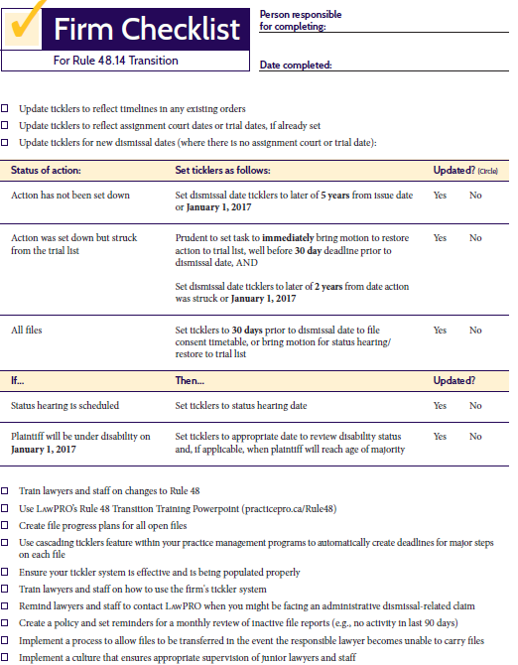
Rule 48 Transition Toolkit
Firm Checklist
Notes:
Here’s the Rule 48 Transition Toolkit Firm Checklist.
One person (lawyer or staff) should be ultimately responsible for completing it. This person should be able to obtain the information from all lawyers regarding their files. Typically this would be a senior litigation partner or an office manager.
The Firm Checklist walks you through all the steps we just discussed that should be taken firm-wide.

Slide 30
Keep tabs on individual files
Update ticklers for each individual file:
  Dismissal date
  Steps in litigation
  Other important dates
Use a file progress plan, and meet with key staff involved in the file every time it’s updated
Rule 48 Transition Toolkit
Individual File Checklist
Notes:
Every file should have electronic and/or paper ticklers updated to reflect the Rule 48 dismissal date.
As a best practice tickle the major steps in litigation and when they should be done.
Other important dates include status hearings, trial scheduling court, assignment court, pre-trial and trial.
Use the Rule 48 Transition Toolkit individual file checklist to determine the Rule 48 dismissal date.
Aside from the Rule 48 dismissal date, important timelines include any pre-existing status hearing dates, orders which require the matter to be set-down by a certain date, trial scheduling court/assignment court dates, and of course pre-trial and trial dates.
Now we’ll take a quick look at the Individual File Checklist, which LAWPRO designed to help you keep tabs on individual files.

Slide 31
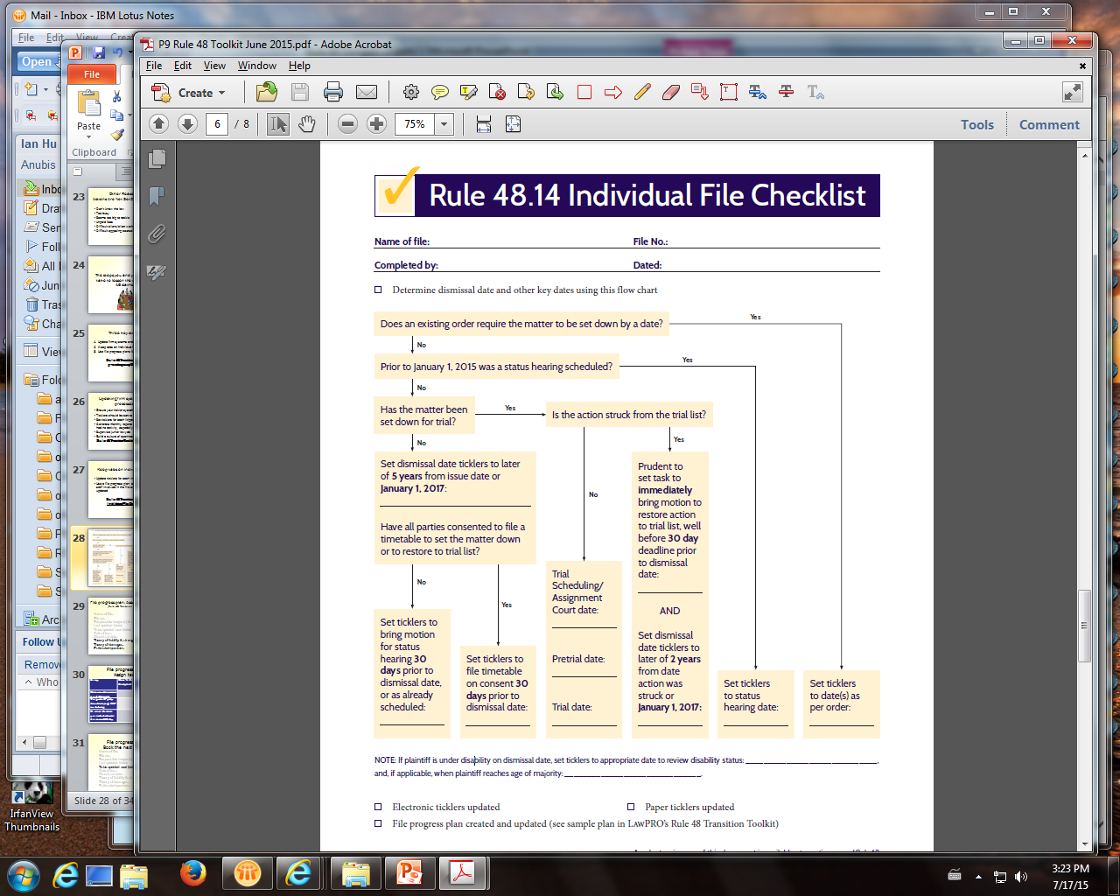
Rule 48
Transition Toolkit
Individual File Checklist
Notes:
This is the Rule 48 Transition Toolkit Individual File Checklist. A copy of this checklist can be printed and placed into every file. One lawyer or staff responsible for the file should complete it.
Note that the flow chart is a quick and easy way to determine the Rule 48 dismissal date that applies to any file. It will also help you determine other key dates such as status hearings, trial scheduling court, assignment court, pre-trial and trial.

Slide 32
Keeping track of a file
Multiple ways to keep track. A good system:
  Makes sure litigation steps proceed quickly
  Keeps track of what has been done and what needs to be done, and by whom
  Is easily transferable to other lawyers if the need arises
Rule 48 Transition Toolkit
File Progress Plan
Notes:
There are multiple ways to keep track of a file. Some firms use practice management software. Have systems and processes in place to review files, such as a quarterly or monthly paper review. The riskiest is having no system at all.
A good system must make sure litigation steps proceed quickly and records what has been done, what needs to be done, and by whom. If the lawyer falls ill or is unable to continue work, another lawyer should be able take over the file and understand what stage of litigation the file is in, and be able to carry the file from there.
Using a file progress plan for every litigation file can help you ensure proper steps are taken in a timely manner. Let’s take a closer look at the file progress plan and how it works in the next few slides.

Slide 33
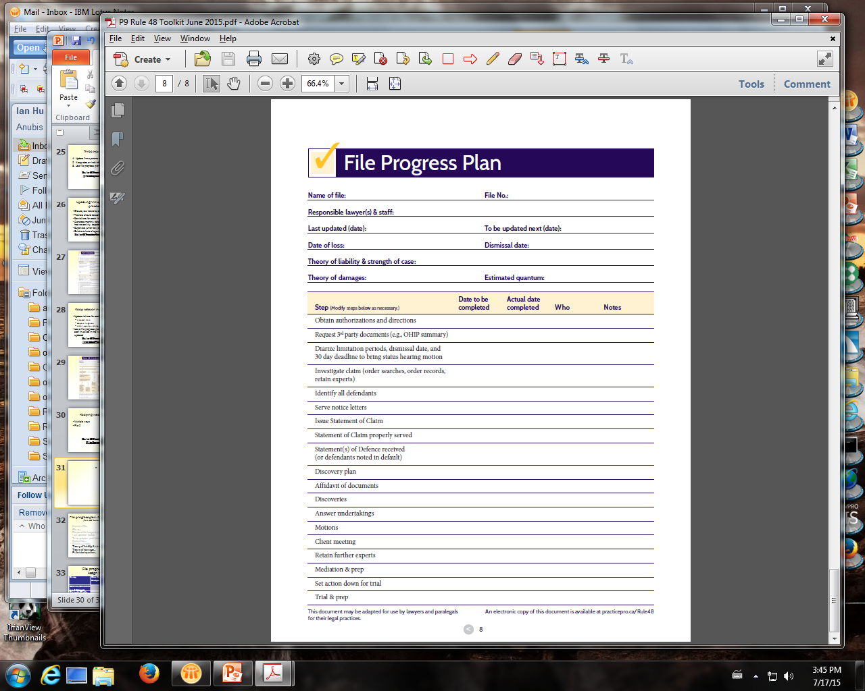
Rule 48
Transition Toolkit
File Progress Plan
Notes:
This is the file progress plan. LAWPRO recommends using a file progress plan for every litigation file. You can keep it electronically or on paper for every file. The Word document can be downloaded at practicepro.ca/Rule48. Save it to your file’s folder or in your practice management software, and keep it updated.

Slide 34
File progress plan:
Header information
Name of file: Smith v. Smith
File no.: 000135
Responsible lawyer(s) & staff: Jill, Tom (A)
Last updated (date): July 15, 2015
To be updated next (date):September 15, 2015
Date of loss: February 1, 2015
Dismissal date: February 1, 2020
Theory of liability & strength of case: ...
Theory of damages: …
Estimated quantum: $50,000
Notes:
When you open a file, meet with everyone who will be working on the file.
Open up a new template file progress plan and fill in these blanks in the header.
Every field here should be completed. First identify the file by name and file number.
Next list all responsible lawyers and staff, noting who has attended the meeting. Those not in attendance should be noted, such as with an (“A”).
Enter the current date of the meeting in the “Last updated (date)” field. Then enter the date when you anticipate you will want to follow up on the tasks assigned on this file again.
Especially important here are the sections on the theory of liability, strength of case, theory of damages & quantum. This is your initial assessment of the case and will guide how you will invest in it. Remember, one of the most common claims stems from not assessing a case properly. A file that is deemed of little value or has liability problems is more likely to languish and be dismissed.

Slide 35
File progress plan:
Assign tasks
Step | Date To Be Completed | Actual Date Completed | Who | Notes
Obtain authorizations and directions
Investigate claim (order searches, order records, retain experts)
Identify all defendants
Serve notice letters
Issue Statement of Claim
Notes:
Next assign tasks for the next steps in the litigation.
Make sure to note when tasks are expected to be completed and by whom.
Add new tasks as necessary.
When this table is updated, fill in when it was updated and by whom.
The “notes” section is there to write in any special considerations. For example, if certain defendants have been properly served but some have not, write it down in the “notes” section under “Statement of Claim properly served”. Then add a task to properly serve the not-yet-served defendants, and/or add a task to bring a motion for substituted service, etc., as necessary.

Slide 36
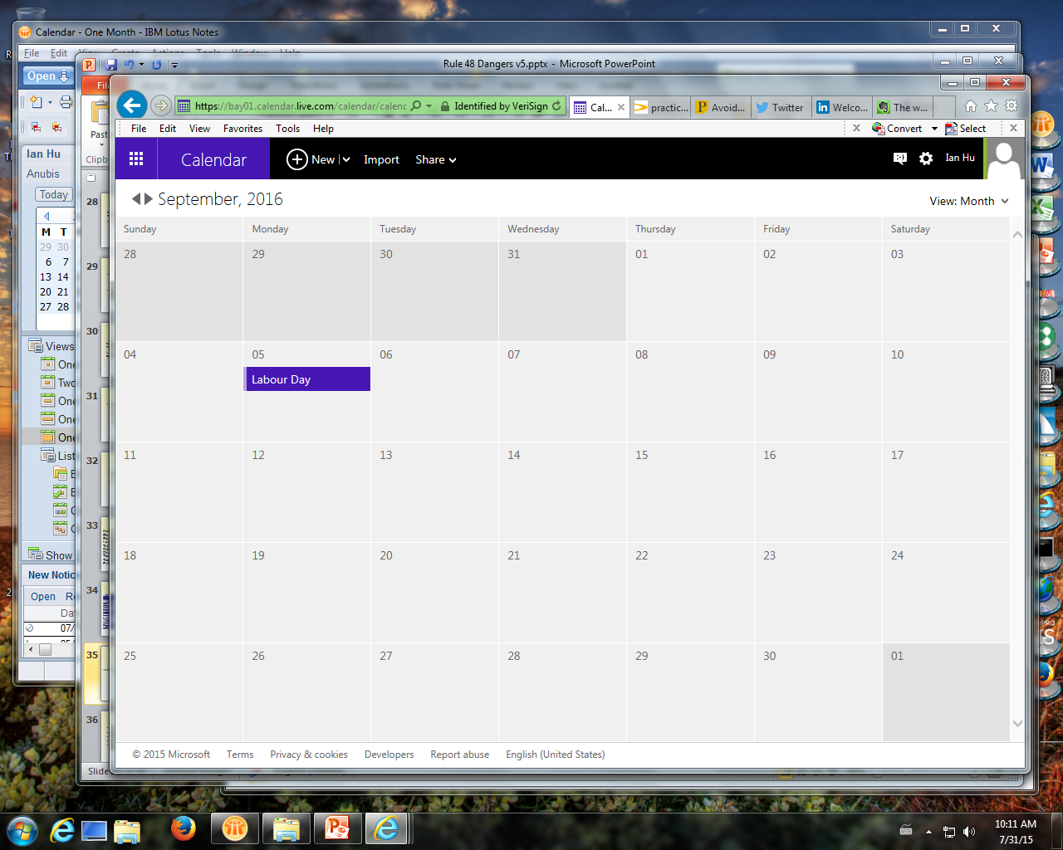
File progress plan:
Book the next meeting
Smith file:
file progress plan
update meeting
Notes:
When you have assigned tasks and reviewed what has been done, set a date to meet and update the file again.
Book the next meeting date with everyone involved in the file.
The file will be less likely to fall through the cracks so long as there is always a meeting booked at a timely point in the future to follow up.
All done? Save the file progress plan to your file’s folder or in your practice management software’s file.

Slide 37
TOP 6
FREQUENTLY
ASKED
QUESTIONS
Notes:
There are two really big changes you need to be aware of.
First, automatic dismissals of claims occur in these scenarios:
actions will be automatically dismissed for delay if not set down for trial 5 years after commencement, and
any action struck from trial list, and not restored by second anniversary of being struck, will be dismissed on that date.
Second, you will no longer receive a status notice to attend a status hearing.
Status hearings have mostly been eliminated. The only time you’ll go to a status hearing is if one has been previously booked, if counsel has brought a motion for a status hearing, or if a court orders one.
This means the onus is completely on you and your staff to make sure your file does not languish past the dismissal date. The court will not provide you with any warning that your file is old and about to be dismissed. We will go through the steps you need to take later in this presentation.

Slide 38
The main action is administratively dismissed under Rule 48.
What happens to related
counterclaims, crossclaims and third party claims?
Notes:
Counterclaims, crossclaims, and third party claims are dealt with under Rule 48.14(9), which refers to Rules
24.03 to 24.05. This requires us to cross-reference Rules 24.03 to 24.05. When the main action is administratively
dismissed under Rule 48 (remember to set appropriate tickler dates):
• A defendant’s counterclaim to the main action will be dismissed without costs within 30 days absent a notice
of election to proceed (Rule 24.03);
• A defendant’s (to the main action) crossclaim or third party claim is deemed to be dismissed (Rule 24.04(1)); and
• A defendant to the crossclaim can have the crossclaim deemed to be dismissed by sending a copy of the
dismissal order to the crossclaimant (Rule 24.02(1.1)).

Slide 39
My case is approaching the Rule 48 dismissal date and I have not set the matter down for trial. I have consent of all parties to a new dismissal date.
Can I simply file a new timetable with the registrar or must I bring a motion for a status hearing?
Notes:
You can file a consent timetable with the registrar, but must do so at least 30 days before the dismissal date. The
timetable must identify the steps needed to set the matter down for trial, sets the deadlines for each step, AND
set a dismissal date no more than two years from the current dismissal date. See Rule 48.14(4).
If the conditions above cannot be met, you must bring a motion for a status hearing. If the status hearing will
not go on consent, notify LawPRO as this is now a potential claim.
lawpro.

Slide 40
What are the cost consequences when an action is administratively dismissed under Rule 48?
Notes:
While Rule 48 does not address costs, a Rule 48 administrative dismissal
is an action dismissed for delay. Under Rule 24.05.01, if an action is
dismissed for delay, any party may, within 30 days of the dismissal, make
a motion respecting the costs of the action (Rule 24.05.01).

Slide 41
I have a court order setting a date by which I have to set the matter down for trial.
Which dismissal date applies to my case, the 5-year dismissal date under Rule 48, or the date set
by the court order?
Notes:
The date set by the court order (see Rule 48.14(1)).

Slide 42
I have settled a case which has not been set down for trial.
Should one of the parties bring a motion to dismiss the action, or can we wait for the case to be administratively dismissed under Rule 48.14?
Notes:
While it is possible to let an action that has settled sit dormant until it is administratively dismissed under Rule 48.14,
there is a risk that one of the parties may renege on the settlement and suddenly take steps in the action. This
may occur, for example, if one of the parties has “buyer’s remorse” or if the settlement is not executed properly
or in a timely manner. Typically, when an action is settled, one of the parties brings a motion to dismiss the
action to help achieve closure.
(As with any settlement, remember that if it involves a party under disability, the settlement must be approved
by a Judge under Rule 7.08.)

Slide 43
Does Rule 48 apply to a family law action?
Notes:
Rule 48 of the Rules of Civil Procedure applies to civil proceedings in the Court of Appeal and in the Superior
Court of Justice. Under Rule 1.02, the Rules of Civil Procedure, including Rule 48, do not apply to proceedings
governed by Ontario Regulation 114/99 Family Law Rules, except as provided. If there is a combined proceeding
where both the Rules of Civil Procedure and the Family Law Rules may apply, the parties may agree, or obtain a
court order, that the Family Law Rules apply to a part or all of the combined proceeding – in this circumstance
parties may consider whether Rule 48 should apply to the combined proceeding or not, and take appropriate steps.
Remember, under the Family Law Rules, Rules 39, 40 and 41 provide for the dismissal of actions by the clerk,
after service of a notice of approaching dismissal if no case conference or settlement conference is arranged
before the 365th day after the date the case was started.

Slide 44
Your marching orders
Learn new Rule 48
Update tickler systems
Move your files along!!!
Use the Rule 48 Transition Toolkit
Contact LAWPRO immediately if you think there might be a claim
Notes:
We’ve seen the best practices.
Your marching orders are to:
Learn new Rule 48.
Update tickler systems – use the firm and individual file checklists in the Toolkit.
Use the Rule 48 Transition Toolkit to ensure you cover all the bases.
Make sure you are moving your files along – and if they are not moving, recognize why and deal with it. Remember the file progress plan in the Toolkit can help you with this.
If you are heading into the dismissal date and cannot obtain consent to file a timetable and draft order, your file is at imminent risk of being dismissed. You must bring a motion for a status hearing which may be contested. Contact LAWPRO immediately so you can get help on dealing with it.

Slide 45







Watch for more info:
lawpro.ca
titleplus.ca
lawpro.ca/excess
practicepro.ca
@lawpro
@practicepro
@titlepluscanada
LAWPRO
LAWPRO staff
LAWPRO
TitlePLUS Home Buying Guide
Notes:
Look for more information from LAWPRO in the coming months, including some friendly reminders to implement the changes required by Rule 48 and to take timely steps on your files.

Slide 46
For more information on Rule 48-related claims and risk management contact
Dan Pinnington
Vice President, Claims Prevention & Stakeholder Relations
LAWPRO, Toronto, Ontario
(416) 598-5863 or 1-800-410-1013
dan.pinnington@lawpro.ca

